Slide 1
Flex Your ILLiad Muscles: Maximizing the Strength of Your Online Web Presence
Logan Rath, The College at Brockport
Kerry Keegan, Atlas Systems

Slide 2
Today’s Interval Training
Warm up
The Equipment & Calibration
Mental Cardio
Free Weights
Better Equipment
Using every machine
Membership management
Personal Training Success Stories

Slide 3
Warm up before you work out
Interval 1
Notes:
Logan

Slide 4
Your Presence Matters
Marketing & Branding
The act of connecting customers
to specific promises of value.
Internal: People. Knowledge. Experience.
External: Benefits over Features
Notes:
Internal
Employee Communication: The face and value of your brand.
External
The customer’s concern: “What’s in it for me?”
The customer’s need: Just get them where they’re trying to go

Slide 5
Your pages should
PROMOTE your library
Be easy to navigate and use
Reflect your department
Give your users a reason to keep coming back
Notes:
Your website is the method and means by which you propel your business into the public consciousness.
Promote Your Library - Establish the image of your ILL department as it functions within the community.
Include relevant information, and then pump it up.
Have a staff directory with photos.
Promote your electronic delivery services, Rapid services, etc.
Be easy to navigate and use
Are the links to your ILL department obvious?
Consider your user’ monitor size!
Consistency and Continuity
Reflect your department
Recognizable Identity - Remind patrons and colleagues they are in your website.
Sidebars, footers, INCLUDE tags, favicons
Create Your Brand
Keep it fresh. Update often.

Slide 6
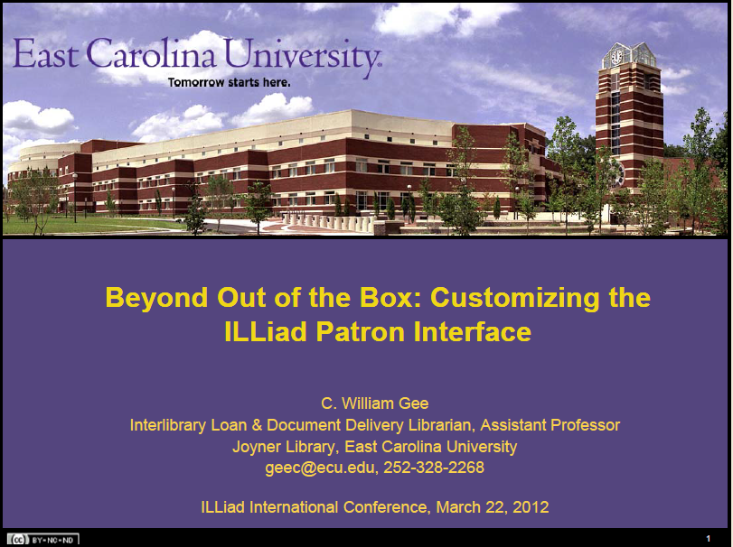
Must Read
Beyond Out of the Box by C. William Gee
http://www.atlas-sys.com/conference/2012-
illiad-international-conference-session-archive/

Slide 7
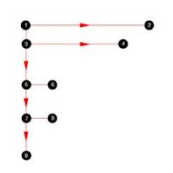
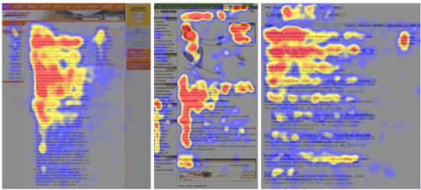
Some Relevant Findings
Eyetracking visualizations show
that users often read Web
pages in an F-shaped
pattern: two horizontal
stripes followed by a
vertical stripe.
Notes:
http://www.nngroup.com/articles/f-shaped-pattern-reading-web-content/#sthash.Fqfexc8t.dpuf
http://1.bp.blogspot.com/_U8PNFRSaEA4/TIdoWH-HBWI/AAAAAAAAAzs/KNw58ULUnh0/s1600/F-shape.png

Slide 8
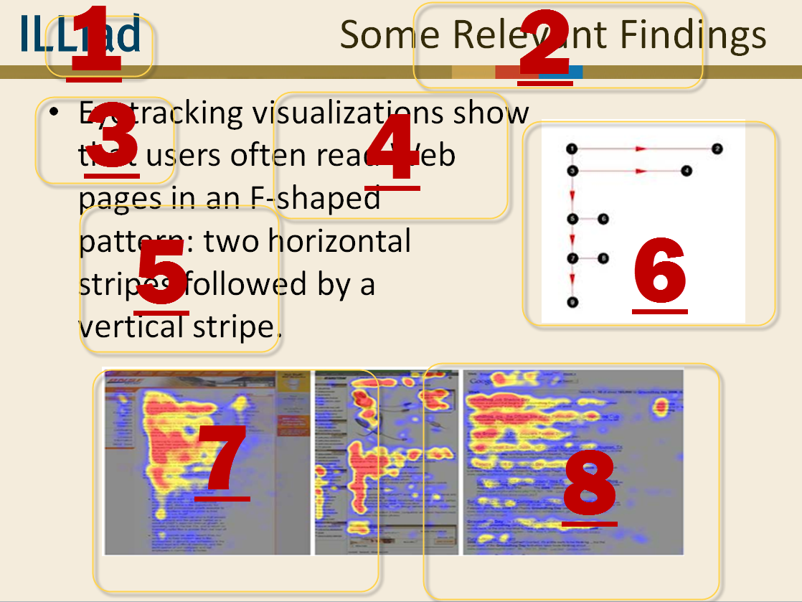
Recapping the Last Slide

Slide 9
Implications of the F Pattern
Users won't read your text thoroughly
The first two paragraphs must state the most important information
    Even more people never make it passed the first
Start subheads, paragraphs, and bullet points with information-carrying words
    Readers see the third word on a line far less than the first two
Notes:
http://www.nngroup.com/articles/f-shaped-pattern-reading-web-content/

Slide 10
How to Write for the Web
Concise, Scannable, & Objective
A study of 5 writing styles found that web sites scored higher in usability when they were:
    Written concisely (58%)
    Text was scannable (47%)
    Objective instead of promotional style (27%)
  Combining all 3 resulted in 124% higher
  measured usability
Notes:
http://www.nngroup.com/articles/concise-scannable-and-objective-how-to-write-for-the-web/

Slide 11
How to Write for the Web
Web users scan, not read, and look for key words and sentences
    Short text, summaries, & numbers as numerals
Avoid scrolling if possible
    10% of users scroll, looking for links below the fold
Marketing fluff decreases satisfaction
    Want speed and pictures aren’t worth waiting for
      Graphics must be meaningful and helpful
Notes:
http://www.nngroup.com/articles/concise-scannable-and-objective-how-to-write-for-the-web/
http://www.nngroup.com/articles/applying-writing-guidelines-web-pages/
Students not reading their email before coming to the desk to pickup something you cancelled.
Or ANY instructions

Slide 12
Microcontent: Headers, Titles, Subject Lines
Microcontent is 40-characters that explain macrocontent
  Online, headers are often displayed out of context
    They must be able to stand on their own
      Guidelines for microcontent:
        Imagine as an ultra-short abstract
        Skip leading articles like “the” and “a”
        First word must be an information-carrier of the concept
        Page titles should not start with the same word
Notes:
http://www.nngroup.com/articles/microcontent-how-to-write-headlines-page-titles-and-subject-lines/
Limited attention spans - Twitterize your stuff

Slide 13
The equipment & Calibration
Interval 2
Notes:
Kerry

Slide 14

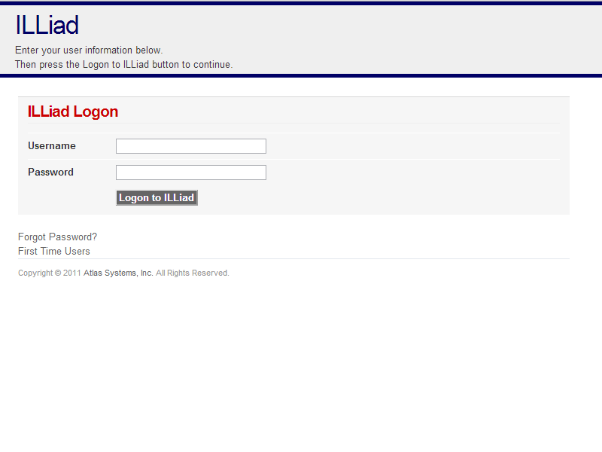

Web Pages, Customization Manager and the DLL
Notes:
Web pages, CM, DLL
How they’re interconnected
Explain that the DLL is NOT customizable
DLL (dynamic link library) – Executable file that allows computers to share code and other resources necessary to perform particular tasks.
DLL – core muscles
Customization manager – yoga moves - flexibility / stretching
Web Pages – Workout clothes –

Slide 15
Changes Using the Customization Manager
Notes:
Still Kerry – YOGA / Flexibility

Slide 16
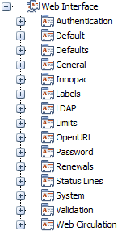
Web Interface Keys
Notes:
Authentication
Defaults
General
Automatic Renewals
Labels
WebFormValues
Change SubmitButtonText, not SubmitButtonValue
Change on page in HTML as well
Limits
OpenURL
OpenURLMapping table
Renewals
RenewalBeforeWindowDays
-1 lets customer renew on the due date, but not after
RenewalWindowDays
5 lets customer start requesting a renewal 5 days before the due date
Status Lines
Can change the text that is displayed
SLBlocked
System
WebSessionMinutes
Validation
WebValidation table
Controls which fields are required on web forms
Uses Regular Expressions
To test search ILLiad documentation for Regular Expression Test or go to:
http://www.atlas-sys.com/products/illiad/illiadregex
Web Circulation

Slide 17
Web Validation vs.
Required HTML Fields
Controls which fields are required
Can be applied to any field on any form in the ILLiad Web
Controlled by the WebValidation table located in the Customization Manager
Site specific on shared server environment

Slide 18
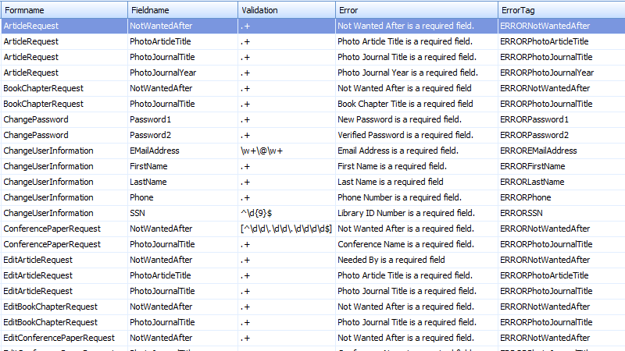
Web Validation
Notes:
Entries in the WebValidation table
– Make fields required
– Establish acceptable values
Required fields on the default web pages have also have default validations in the table
Adding and removing validations allows you
to customize your web interface
Stores customized error messages for validation errors displayed in the web
Add <span class="req">*</span> to the HTML page
Add entry to the WebValidationtable
Locate an entry for the same page
Click Copy Record then edit the fields as needed
Click Save
Repeat these for the ‘Edit’ page
To remove a Web Validation, reverse the process
Validation is controlled using Regular Expressions
Tools available to help build and test more complicated validations
ILLiad Regular Expression Validator –Atlas created tool to test regular expressions however it does not provide troubleshooting assistance.
Expresso –Free download! It allows you to create and test regular expressions while providing troubleshooting assistance too!

Slide 19
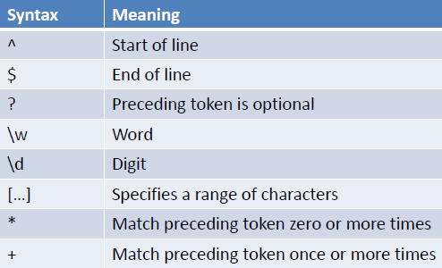
Regular Expressions
Status
  –‘Choose a Status’ is not an acceptable value
  ^(?!(Choose a Status))
Email
–Requires a valid email address format
^(\w+@[a-zA-Z]+?\.[a-zA-Z]{2,6})$
^(\w+@(?:[a-zA-Z]+\.)+[a-zA-Z]{2,6})$
–Parton must use company or university email address
^[_a-z0-9-]+(\.[_a-z0-9-]+)*@sunnybeach\.edu$
^[_a-z0-9-]+(\.[_a-z0-9-]+)*@([a-z0-9-]+\.)*sunnybeach\.edu$
SSN
–15 digit ID Number
^\d{15}$
–B prefix preceeding 15 digit ID Number
^(B)\d{14}$
–15 digit ID Number that begins with 209
^(209\d{12})$

Slide 20
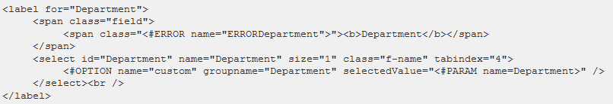
Custom Dropdown
Specifies values that apply to certain dropdown fields on the registration and change user information forms
  Values set in the CustomDropDown table in Customization Manager.
    Department, State and Status set by default
    NVTGC that populates Delivery Location set by default

Slide 21
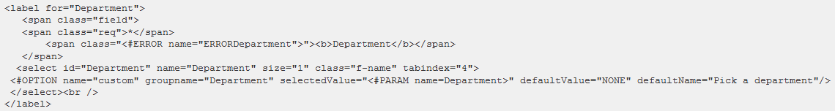
Custom Dropdown
Add optional dropdown values using DefaultName and DefaultValue
    DefaultValue = Label Value
    DefaultName = Label Name that displays on form
    Name must be indicated as “custom”
    GroupName = Groupname in CustomDropDown table
    SelectedValue represents default selection

Slide 22
Status Lines
Appear on web pages to highlight special information.
    Used to notify users of an omission on a form, an action taken (e.g., a user cancels a request), or an error on the page.
By default, the status lines display in the ILLiad header, you can put them in other locations on your web pages.
You can also change the text displayed for each status line in the Customization Manager.

Slide 23
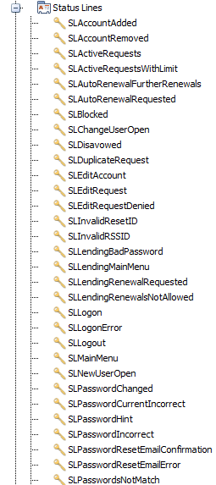
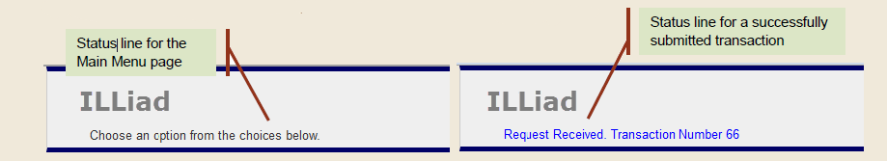
Status Lines

Slide 24
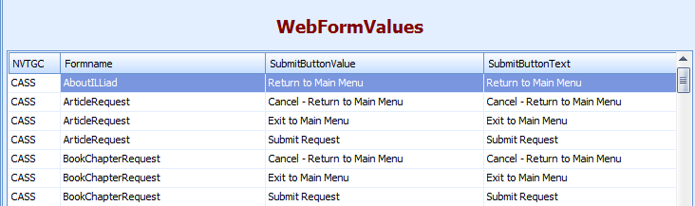
Button Labels
Changing the text on the submit buttons
WebFormValues in the ILLiad Customization Manager
      Customization Manager -> Web Interface -> Labels -> WebFormValues
      Change only “SubmitButtonText” value

Slide 25
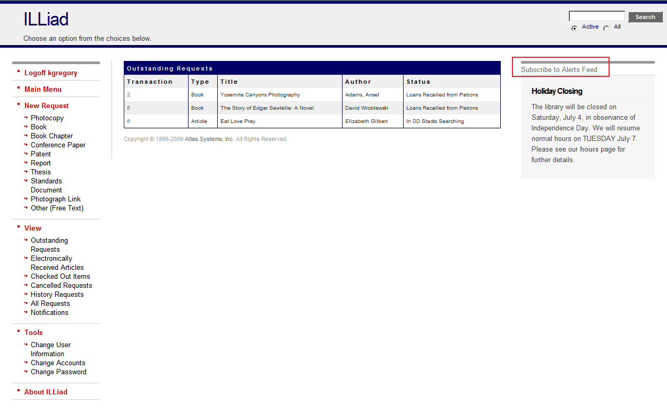
RSS Feeds & Alerts
Can receive feeds of Email Notifications and Web Alerts
  Direct to a feeder or email inbox
  Subscribe button on ViewNotifications.html and ILLiadMainMenu.html
Preferences set in Customization Manager
    RSSAlertsDescription
    RSSAlertsTitle
    RSSNotificationsDescription
    RSSNOtificationsTitle
Notes:
Animated – button will show web page

Slide 26
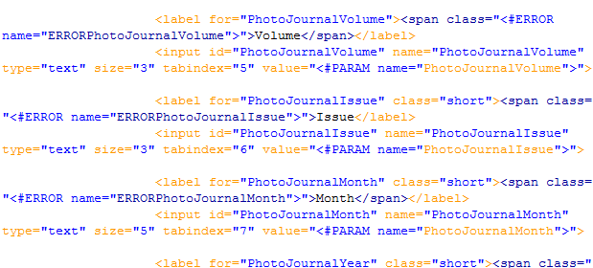
Mental cardio: Understanding code
Interval 3
Notes:
Logan

Slide 27
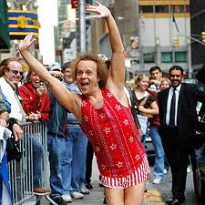
ILLiad Web Overview
Standard HTML files, server through a DLL that interfaces with SQL Server
Compatible with any web browser that supports tables and forms
Picture courtesy chess.com
Notes:
HTML files are like your workout clothes – they can be ugly but still get the job done
ANIMATED – RICHARD SIMMONS!!!!!

Slide 28
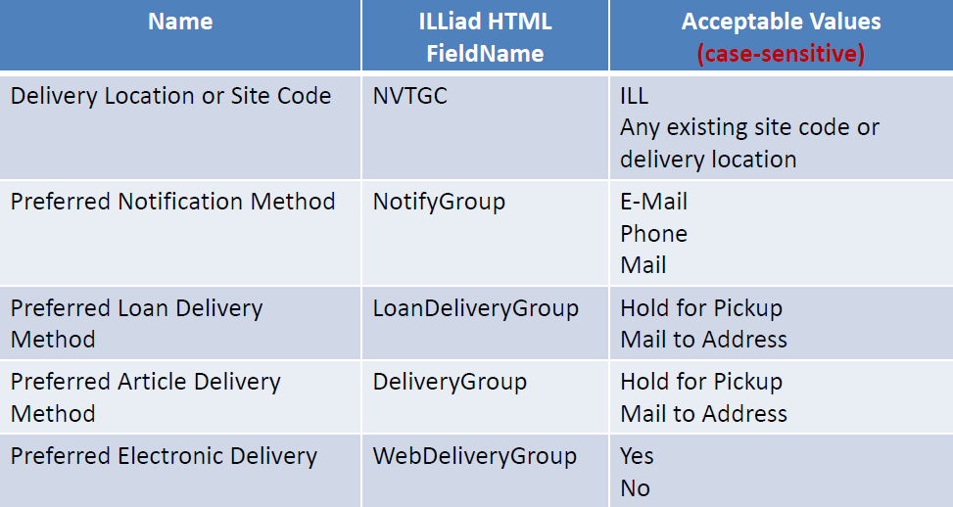
Required HTML fields
Five required HTML fields
Required by the database
Must exist on both your registration form
and change user information pages
  NewAuthRegistration.html
  NewUserRegistration.html
  ChangeUserInformation.html
  Predefined ‘Acceptable Values’
May be assigned as a hidden field
Notes:
You must have these or ILLiad will break and you’ll hate your life.

Slide 29
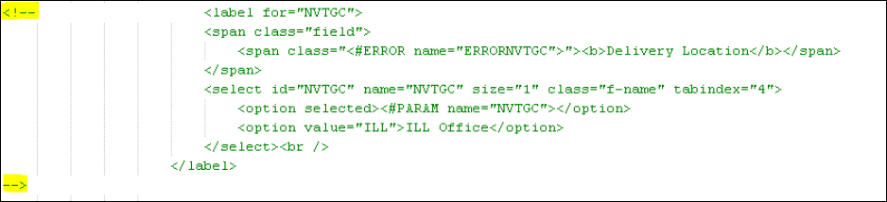
Hiding Required Fields
Comment out the field tag in the HTML
  – HTML comment tag
  <!--Text you want to hide -->
  Add a hidden field to the HTML
  Example of HTML & Hidden Field
Notes:
Good news – you can hide them!

Slide 30
Branding Pages Breakdown
Adding headers
  logon.html and logon2.html
  include_header.html
  include_header_request.html
Adding footers
  logon.html and logon2.html
  include_footer.html
  include_footer_request.html
Other aesthetics
  Main.css
  Print.css
Notes:
WORKOUT CLOTHES AGAIN
Standard html pages are included in the default set to convey instructions, policies, and procedures to patrons.
The main default text pages are:
FirstTime.html
The page a user sees before she reaches the registration page
FAQ.html
A page linked to from the first time user page
<a href="FAQ.html" target="_self">FAQ</a>
AboutILLiad.html
A page linked from the main menu
<li class="active"><a href="<#ACTION action="10" form="1">">About ILLiad</a></li>
ElectronicDeliveryInformation.html
A page linked from the FAQ
<a href=“ElectronicDeliveryInformation.html" target="_self">Electronic Delivery Information</a>

Slide 31
The Style Sheets
main.css
  <link rel="stylesheet" type="text/css" href="css/main.css" media="screen" />
print.css
  <link rel="stylesheet" type="text/css" href="css/print.css" media="print" />
mobile.css
  <link rel="stylesheet" type="text/css" href="css/mobile.css" media=“mobile" />
Notes:
31
Links can all be displayed in different ways in a CSS-supporting browser:
a:link {color: #FF0000} /* unvisited link */
a:visited {color: #00FF00} /* visited link */
a:hover {color: #FF00FF} /* mouse over link */
a:active {color: #0000FF} /* selected link */
Note: a:hover MUST come after a:link and a:visited in the CSS definition in order to be effective!!
Note: a:active MUST come after a:hover in the CSS definition in order to be effective!!

Slide 32
ILLiad Code to Know
#ACTION | Builds a link. | <a href="<#ACTION action="10" form="21">">Book</a>
#INCLUDE | Displays the contents of another file. | <#INCLUDE filename="include_header_request.html">
#PARAM | Displays a parameter value. | <input type="hidden" name="SessionID" value="<#PARAM name="SessionID">">
#TABLE | Displays a table. | <#TABLE name="ViewOutstandingRequests" headerText="Outstanding Requests" noDataAction="ShowMessageRow" noDataMessage="No Requests" column="TransactionNumber:Transaction" column="DocumentType:Type" column="Title" column="Author" column="TransactionStatus:Status">
<#ALERTS> | Displays the Alerts list.
#LOCALINFO | Displays a value from LocalInfo table for current NVTGC. | <#LOCALINFO name="GeneralEMailAddress">
Notes:
32
<# triggers the DLL – this is why Pilates is important - strong core can take any exercise routine to the next level.
The <div> tag defines a division/section in a document.
Tips and Notes
Note: Browsers usually place a line break before and after the div element.
Tip: Use the <div> tag to group block-elements to format them with styles.
Include statement is specific to ILLiad DLL – SSI is not required

Slide 33
ILLiad Code to Know
#CUSTOMIZATION | Displays a value from Customization table. | Ex. Text on web: By default all users are given a delivery method of <#CUSTOMIZATION name="WebDefaultDeliveryGroup">
#Transaction | Displays a value from Transactions table. | <#Transaction name="TransactionNumber">
#User | Displays a value from Users table. | <#User name="Address"> Ex. Could create link to ChangeUserInformation.html from request form to update user info.
Notes:
33
The <div> tag defines a division/section in a document.
Tips and Notes
Note: Browsers usually place a line break before and after the div element.
Tip: Use the <div> tag to group block-elements to format them with styles.
Include statement is specific to ILLiad DLL – SSI is not required

Slide 34
Intervals 1 - 3 Cool Down
There are three parts to your Web pages
  You cannot edit the DLL
  <#PARAMs> are set by the CM
  You can change the .html pages
  ILLiad specific <#PARAMs> extend basic Web functionality.

Slide 35
FREE WEIGHTS: playing with code
Interval 4
Notes:
Still Logan

Slide 36
Moving the Status Line
The status line code - <div id="status"><#STATUS></div> - can be moved from the include_header.html file to the top of request forms, transactions summary pages, etc.
Notes:
Modifying Status Lines
The text of the various status lines can be found in the Customization Manager in the Web Interface section.
Status lines can be no more than 255 characters.

Slide 37
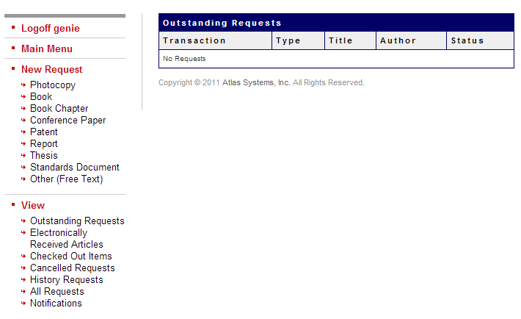
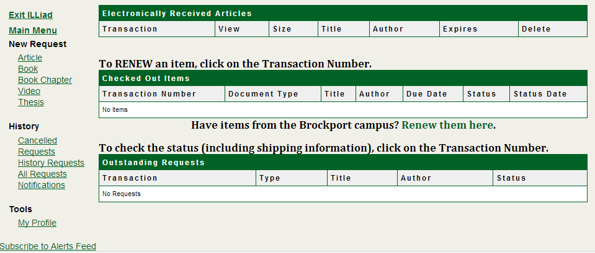
<#TABLE> on ILLiadMainMenu.html

Slide 38
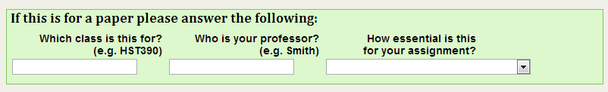
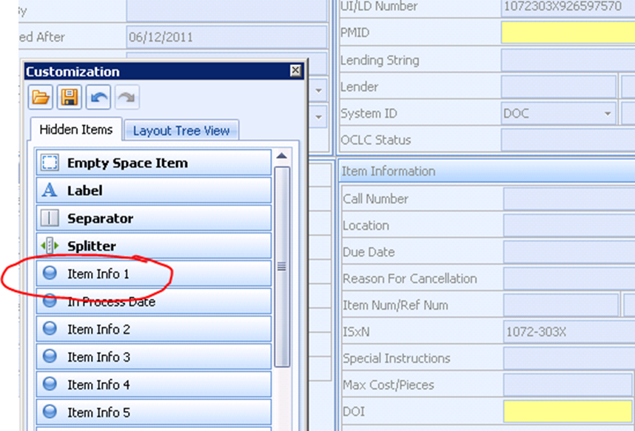
UserInfo 1-5 & ItemInfo 1-5
Flexible database fields iteminfo1-5 and userinfo1-5 can be used in client, on web forms, and on reports.
Define ILLiad field
Sample Code
<label for="ItemInfo1">
<span class="field">
<span class="<#ERRORname="ERRORItemInfo1">"><b>Restrictions on Access</b></span>
<span class="note">Certain materials can only be viewed with the permission of the curator. Please see <a href=http://www.vothlibrary.org/Access target=”_blank”>Access to the Collections</a> for more information.</span>
</span>
<input id="ItemInfo1" name="ItemInfo1" type="text" size="40" class="f-name" tabindex="50" value="<#PARAM name="ItemInfo1">"><br />
</label>
Define display label
Provide explanatory notes
Notes:
Atlas realized we were hacking apart their database and capturing fields for our own profit, so they gave us a kingdom.
Which class is the item for?
Who’s your professor/advisor?
Provide meaningful labels: only you know what ItemInfo1 means!
**Note: If you make a change to a request form, you will also need to make a change to the corresponding edit form, as appropriate.

Slide 39
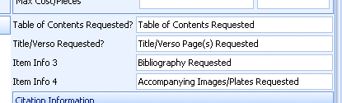
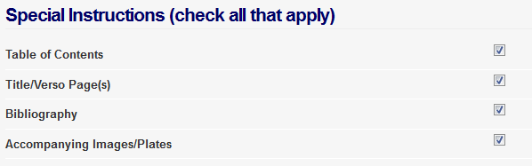
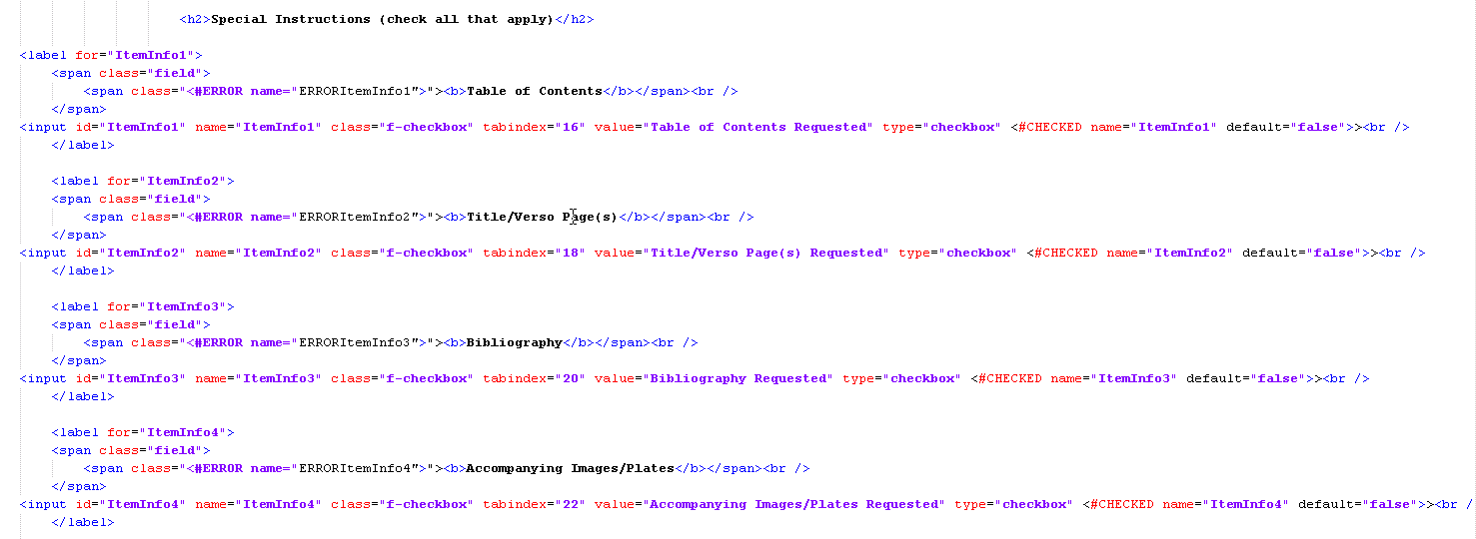
Checkboxes
Notes:
Checkboxes can be used to populate additional information on the request forms
Kerry - USGS

Slide 40

Radio Buttons
Radio buttons can be edited to indicate Search Method or used to customize forms
  Includeheader.html
  <div id="searchType">
  <input name="SearchType" type="radio“ id="SearchTypeActive" value="Active" checked class="f- searchType" /><label for="SearchTypeActive">Active</label>
  <input name="SearchType" type="radio" id="SearchTypeAll" value="All" class="f-searchType" /><label for="SearchTypeAll">All</label>
  </div>

Slide 41
Status Specific Pages
Can create pages for specific patron types
      Eg. Express Delivery just for faculty
    Copy, rename, and save the page you want to use
      Eg. ArticleRequest-Faculty.html
    Update include_menu to reflect the change
      Include_menu-Faculty.html
        If the request options are already in the include_menu,
        you’ll have to replace them with the new page name
    Edit the request page to reflect desired changes
  Also can use GenericRequest pages
Notes:
Place new page in same folder as other html
Default is c:\inetpub\wwwroot\illiad
The DLL will automatically show include_menu.html and link to request forms that correspond with patron status type
Think about using custom queues and routing to expedite processes
Think about status-specific billing for different user types

Slide 42
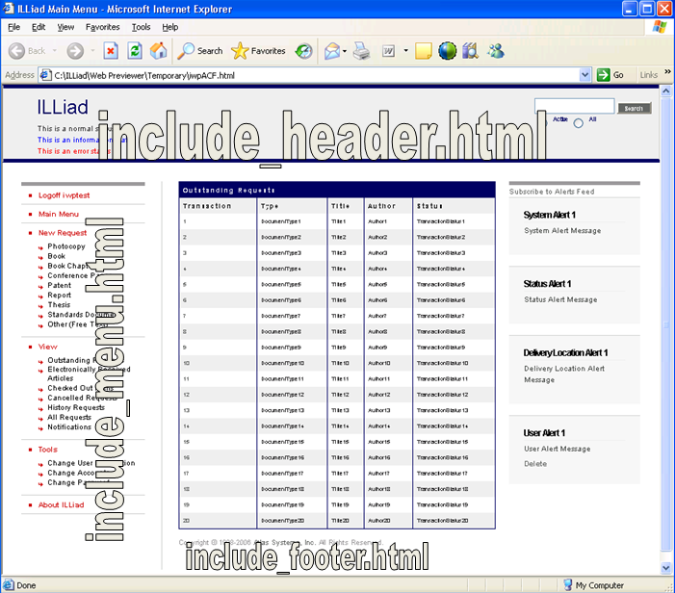
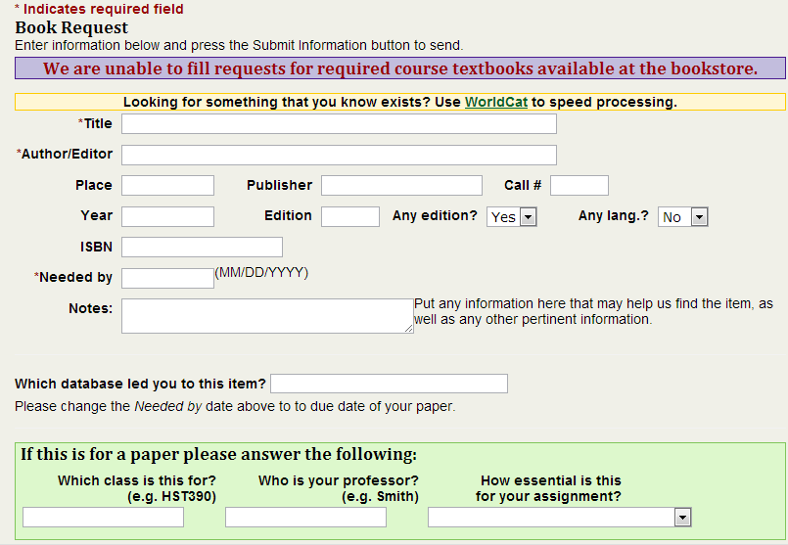
Includes
message-Undergraduate.html
You can <#INCLUDE> any piece of code you need to re-use.
Includes can be status-specific!
Notes:
Includes only work on pages being served through the DLL!
<#INCLUDE>s have to be served through the DLL because they start with a # (database will pull specific patron-type ones).
FAQ, NewUserRegistration,FirstTime,Logon, About

Slide 43
Better equipment: Tools of the trade
Interval 5
Notes:
Kerry

Slide 44
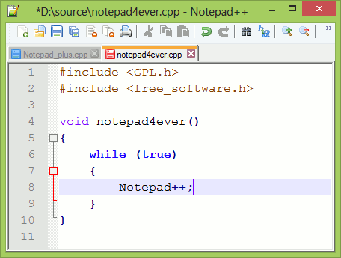
Notepad ++
http://notepad-plus-plus.org/
Free source code editor and Notepad rpelacement

Slide 45
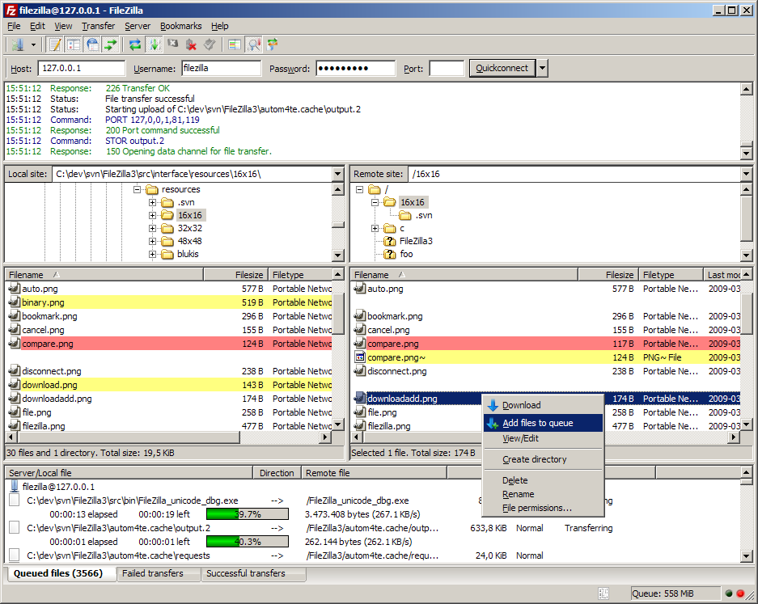
FileZilla
http://filezilla-project.org/
Free client and server FTP solution

Slide 46
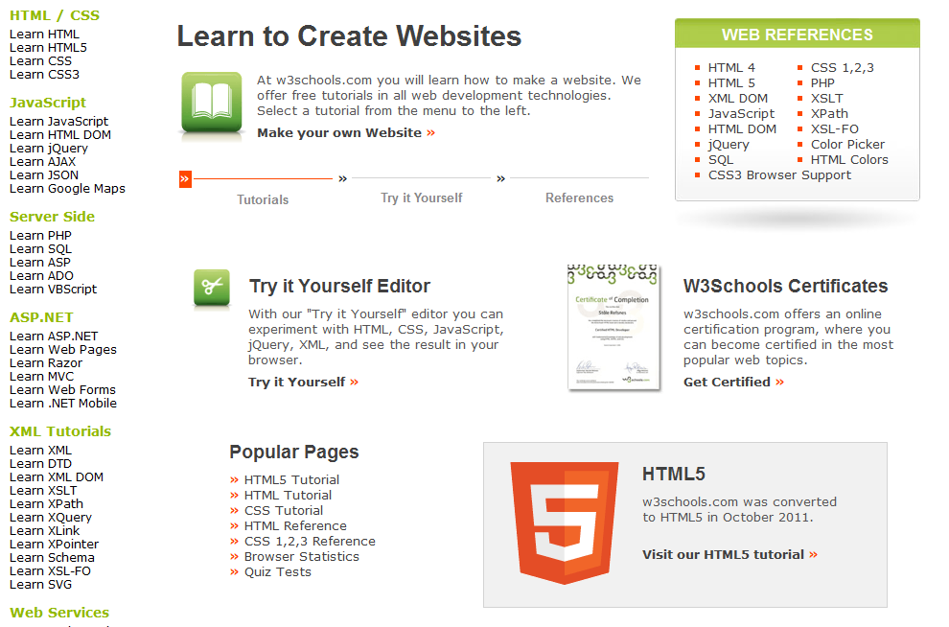
W3C Schools
http://www.w3schools.com/
Free tutorials in all web development technologies
Fun and easy to understand

Slide 47
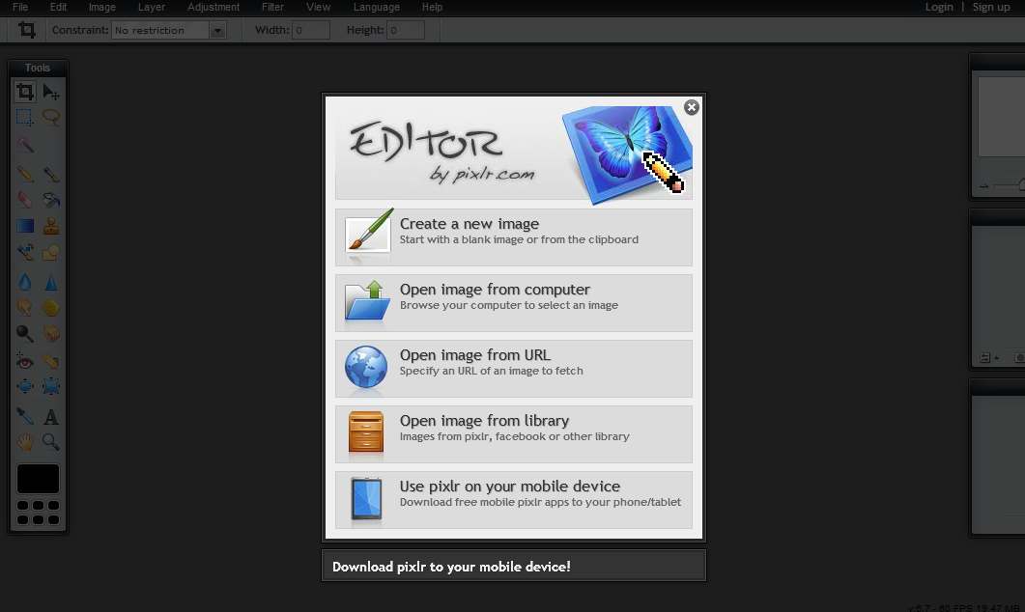
Pixlr
http://pixlr.com/editor/
Like a free version of Photoshop Elements

Slide 48
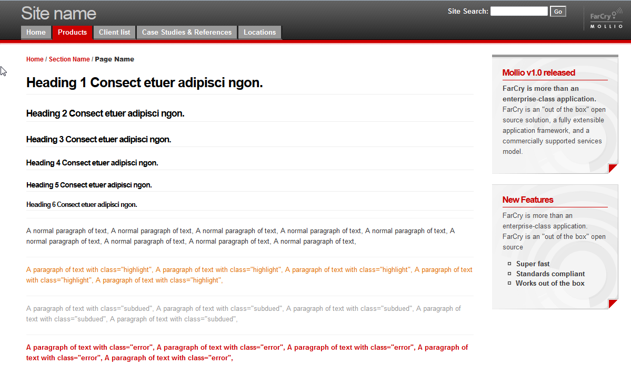
Molio
http://www.mollio.org/
http://www.mollio.org/mollio_style_guide.pdf
Sets of HTML/CSS templates that can be used to create layouts
Sample content and editors

Slide 49
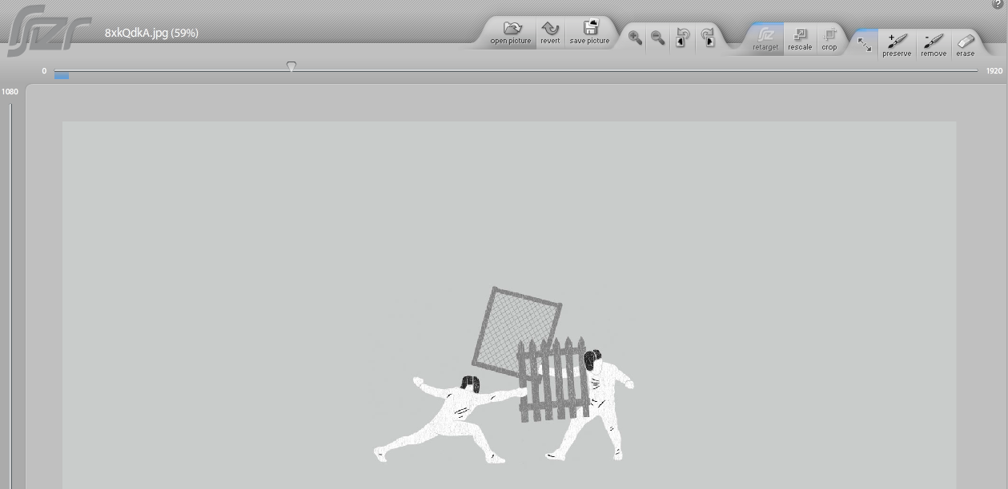
Rsizr
http://rsizr.com/
Resizes images

Slide 50
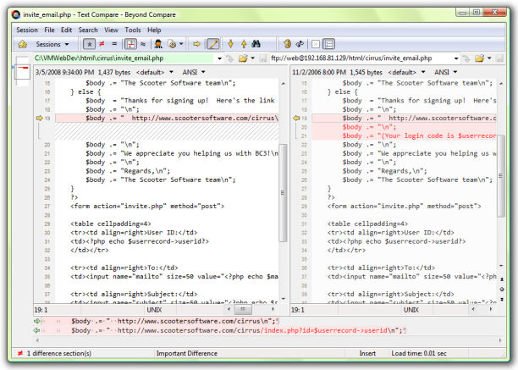
Beyond Compare
http://www.scootersoftware.com/index.php
Compares files and folders
Creates colored views and synchronizes
Free trial or pay to keep

Slide 51
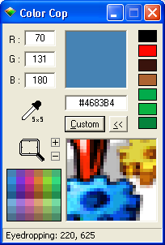
Color Cop
http://colorcop.net/
Free download
Picks colors and returns hex and RGB codes

Slide 52
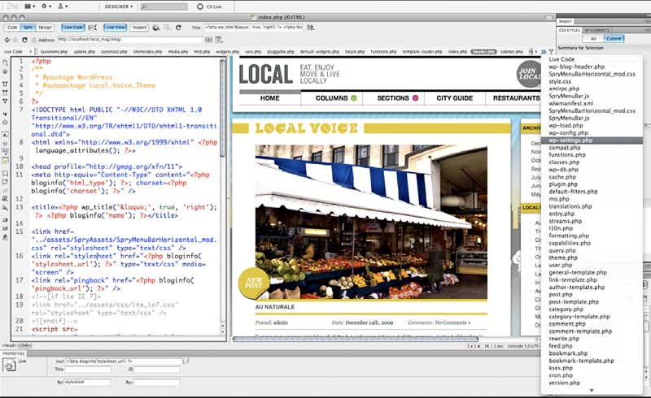
Dreamweaver
http://www.adobe.com/products/dreamweaver.html
Penultimate web development software
Can try for lower cost or lease per year as part of the cloud

Slide 53
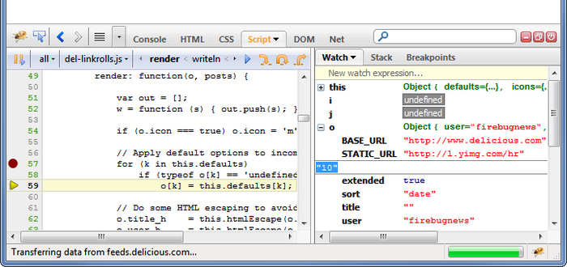
Firebug & other Firefox Web Add-Ins
https://getfirebug.com/
https://addons.mozilla.org/en-us/firefox/addon/firebug/
Edit, debug, monitor CSS, HTML, and JavaScript on any web page

Slide 54
Interval 4 & 5 Cool Down
You can play around with the different parts of the Web Pages
There are tools that can help you.

Slide 55
Using all the machines in the gym (aka circuit training)
Interval 6
Notes:
Kerry

Slide 56
Test Web
All of the changes – none of the panic!
A Test Web folder can use any name and is kept beneath the default ILLiad web folder location.
Webpath.txt serves as an override and keep links directed within this folder
  Example: If you put your test web in c:\inetpub\wwwroot\illiad\testweb, the webpath.txt file inside that folder would have one line that says c:\inetpub\wwwroot\illiad\testweb for the DLL to know where to look for those pages.
Notes:
Explain WHY the WebPath is there
If you break TestWeb, nobody knows where you hid the body (your phone won’t ring!)
If you completely break testweb, contact your ILLiad support and they can put it back.
You can download a full set of ILLiad WebPages online or get them in your update folder on your server
TestWeb is a great way to start using new versions of web pages.
https://prometheus.atlas-sys.com/display/illiad/Customizing+the+Web+Interface#CustomizingtheWebInterface-CreatingaTestWeb

Slide 57
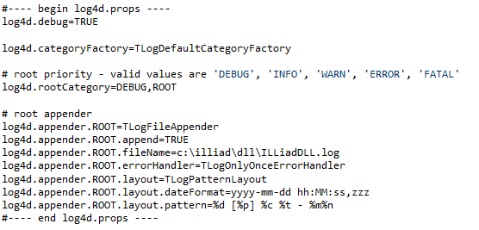
Enabling Logging
Create a file called log4d.props on the web server in the same directory where the illiad.dll is running (usually c:\inetpub\wwwroot\illiad)
The DLL will now log to a file called c:\illiad\dll\ILLiadDLL.log
    This can be edited to another name or location
Notes:
https://prometheus.atlas-sys.com/display/illiad/Setting+up+and+Using+an+ILLiad+DLL+Log

Slide 58
Logging
If you have multiple web folders (shared server or using test web), you can make a different log4d.props file in each web folder that points to another file name for that log.
You may need to change the permissions on the c:\illiad\dll directory (to allow the Internet Guest Account (IUSR_ILLIAD or similar) to create and write to a file.
The file may not allow you to open it while the DLL is still running. You may need to stop and restart the web server to open the file.
Notes:
https://prometheus.atlas-sys.com/display/illiad/Setting+up+and+Using+an+ILLiad+DLL+Log
Sample file available for download here or you can cut and paste.

Slide 59
Disabling Logging
To disable logging in the ILLiad DLL, rename the log4d.props file to something else (i.e. disable-log4d.props). If the DLL cannot find that file, it will not log any actions
Caution About DLL Logging!
DLL Logging should only be enabled to aid in the diagnosis of a problem - the log files tend to get large quickly.
Notes:
https://prometheus.atlas-sys.com/display/illiad/Setting+up+and+Using+an+ILLiad+DLL+Log
Sample file available for download here or you can cut and paste.

Slide 60
MEMBERS ONLY AREA:
Authentication & Patron data
Interval 7
Notes:
Logan

Slide 61
Authentication Scenarios
Patron creates new username for ILLiad
  Patron has to remember username & password
  ILL staff has to clear patron
  ILL staff has to reset forgotten password
Patron uses campus credentials
  AutoClear registered users
  No managing enrollment verification
  No password management
  Local accounts still allowed!
Notes:
No need to verify university affiliation
Autoclear key
No need to verify enrollment status
Can still have nonauth or ILLiad authenticated users
Show dual portal
Mention that some CAS/Shib OCLC hosted sites might need to get EZProxy to connect shib with OCLC server
Don’t have to manage passwords
Don’t have to manage multiple usernames and passwords
Updating U password would update ILLiad
No more “first time users” – already know how to log in
Still have to register for first time
Explain difference between Cleared Yes, Cleared No, and New
Explain difference between those two pages and when they appear
More seamless experience that looks like what your university already has

Slide 62
Hosted Sites & Shibboleth
Configure EZProxy to use Shibboleth
Set up ILLiad in EZProxy
Proxy your ILLiad .dll link
* No Guest Passes Allowed (unless you have a dual-authentication portal)
Notes:
Explain what EZProxy is
Talk about EZP Stanza and the fact that you can set the HTTP_HEADER to ANYTHING.. As long as it matches.
Portal has to have a complete second set of Web Pages that is outside of the directory that is protected by the authentication
(So it’s like a live TestWeb)

Slide 63
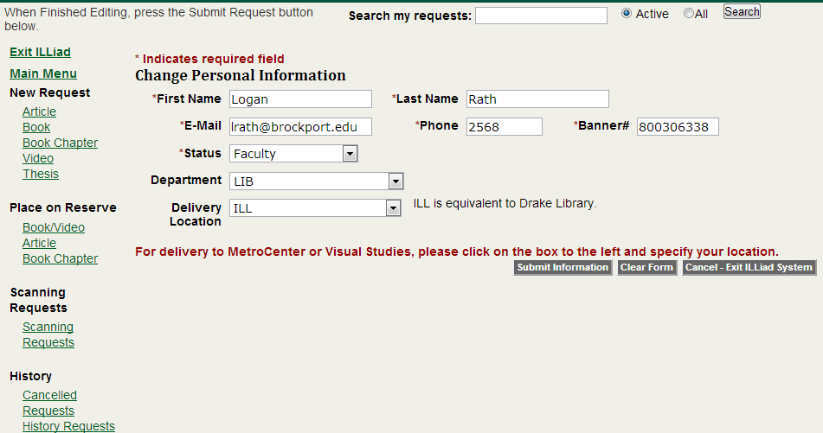
Only collect what you need
If you’re using remote authentication and e-billing, why make them submit their address?
  Better for users
  More accurate and reliable (for staff too)
  Faster, easier, better
Picture courtesy chess.com
Notes:
Refer back briefly to patron API and how this will prefill user info
Graphic of two identical piles of something – old versus shiny and new

Slide 64
Intervals 6 & 7 Cool Down
Use all the equipment available
Only collect data you’ll actually use

Slide 65
Personal training success stories
Interval 8
Notes:
Kerry

Slide 66
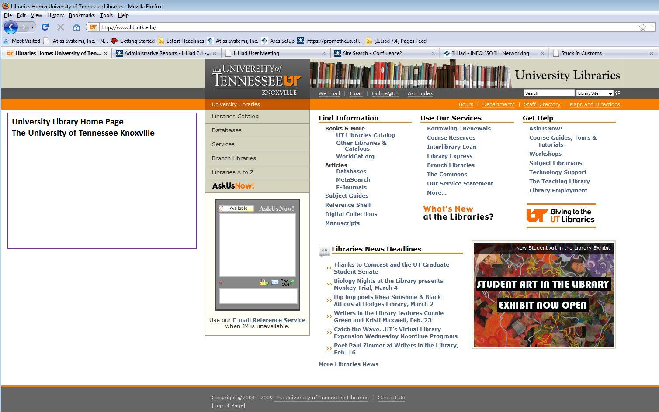
University of Tennessee Knoxville

Slide 67
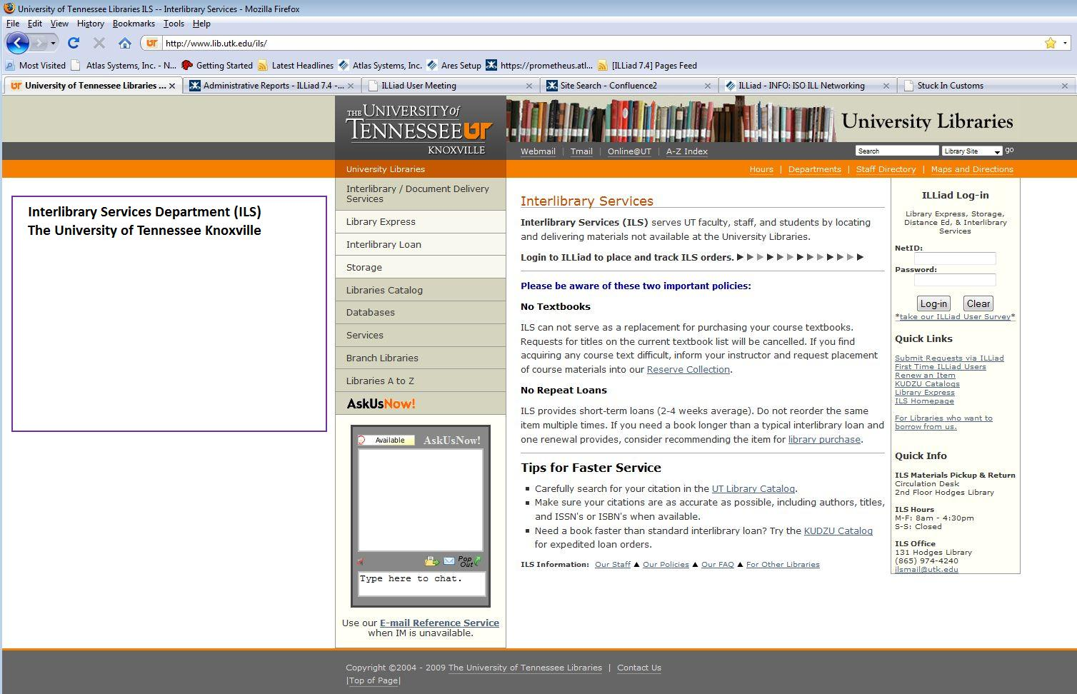
University of Tennessee Knoxville

Slide 68
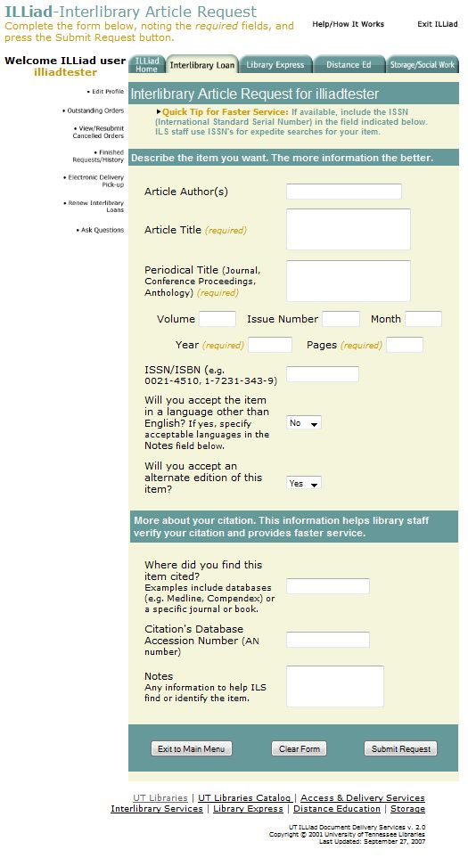
The University of Tennessee
Knoxville
ILLiad
Interlibrary Article Request

Slide 69
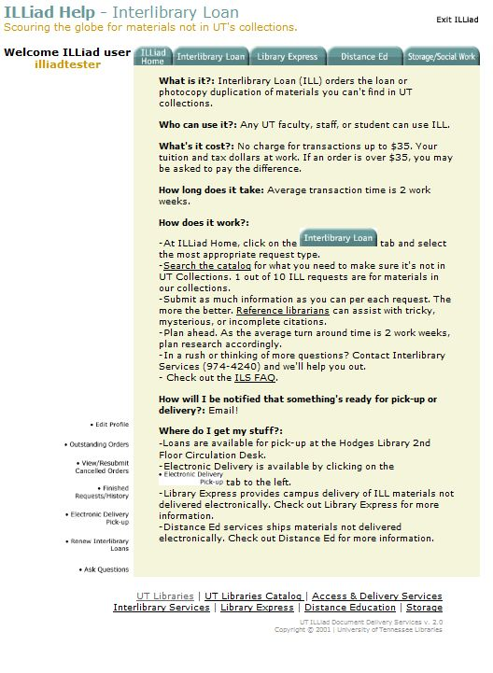
The University of Tennessee
Knoxville
ILLiad Help
Interlibrary Loan

Slide 70
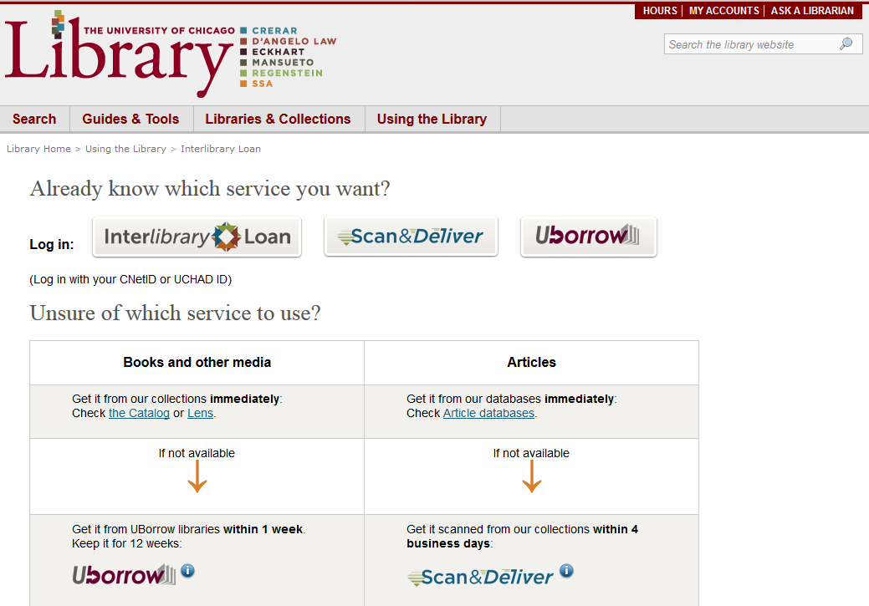
University of Chicago

Slide 71
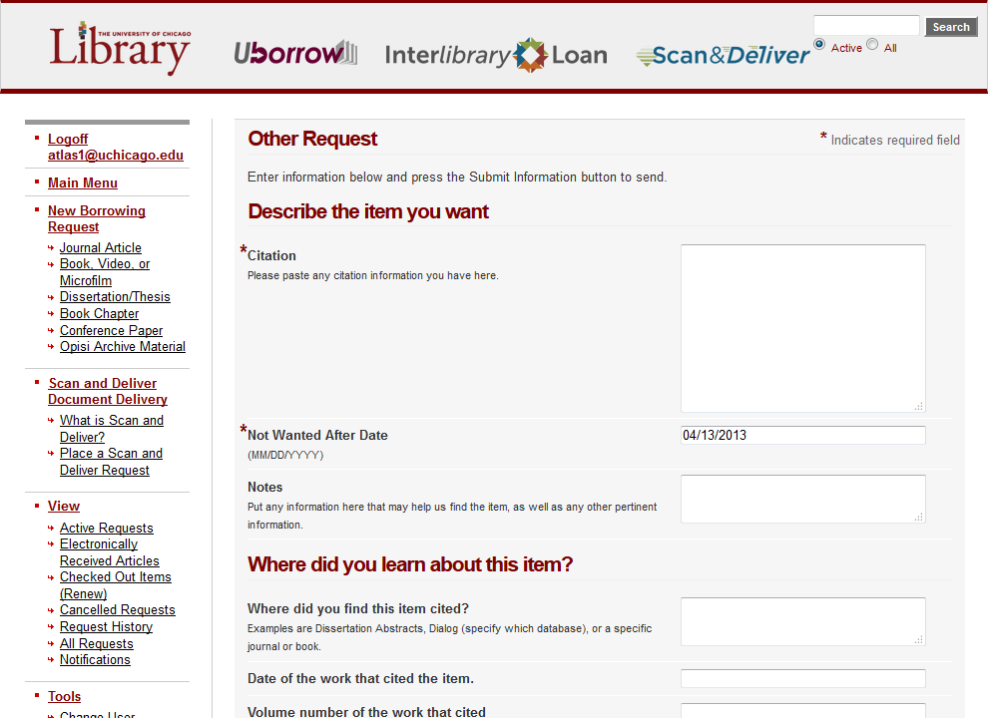
University of Chicago
Notes:
ANIMATED – F your face!

Slide 72
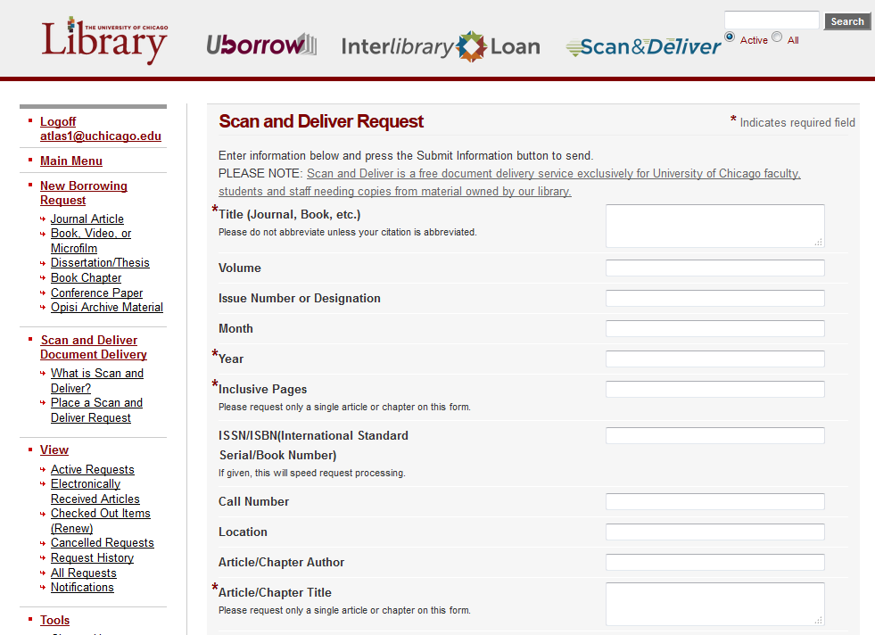
University of Chicago

Slide 73
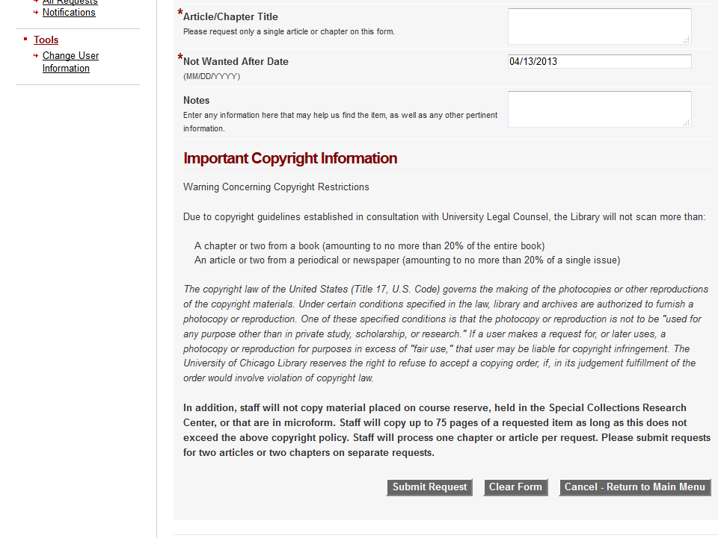
University of Chicago

Slide 74
Brockport’s changes
Interval 9
Notes:
Logan

Slide 75
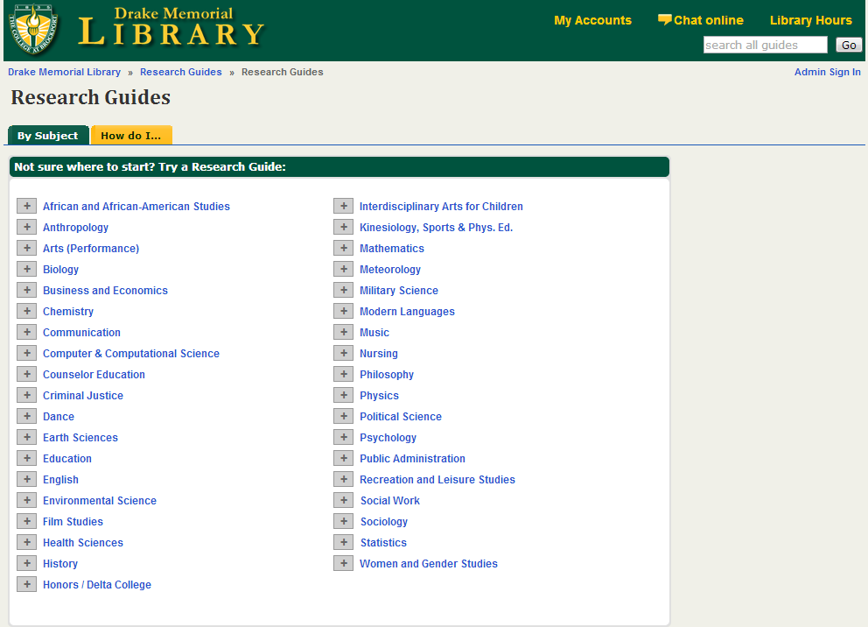
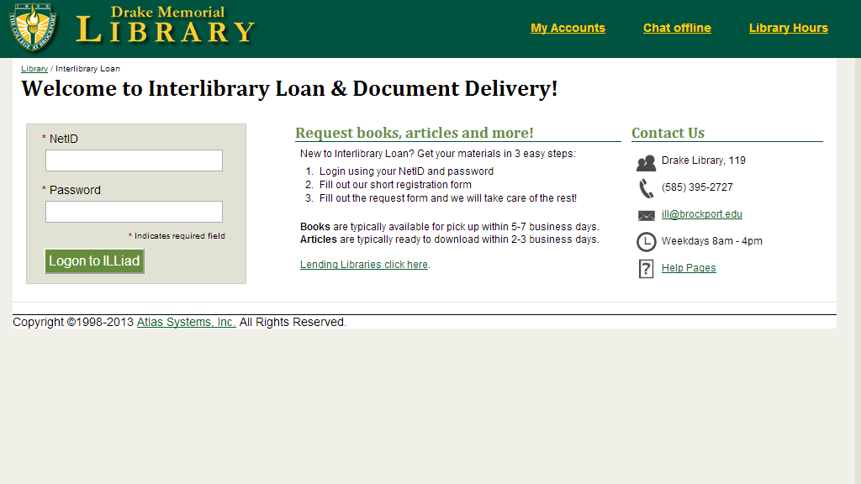
Notes:
Talk about LDAP & Local Accounts

Slide 76
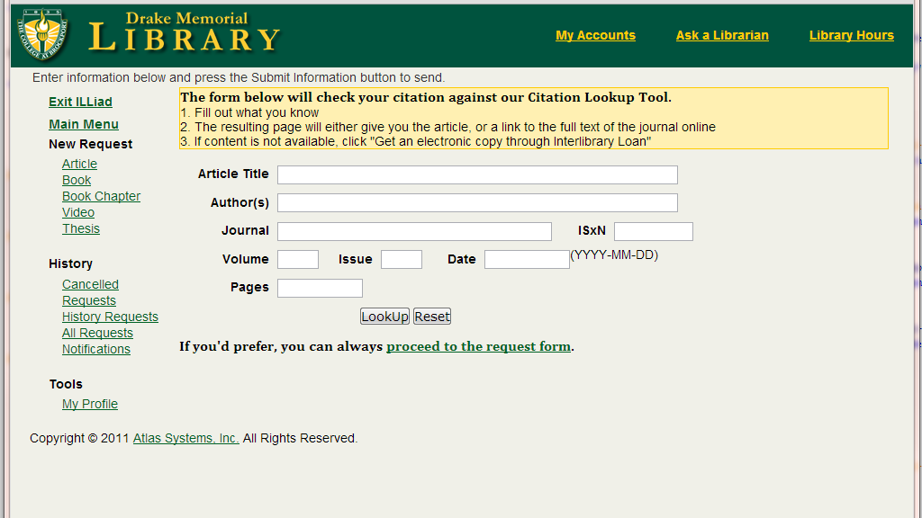
Article Link goes to:
https://brockport.illiad.oclc.org/illiad/illiad.dll?Action=10&Form=20&Value=ArticleLookup
Notes:
New Request Article link goes to HTML page that has the container for our Article Lookup.

Slide 77


Notes:
Actual article request page has lined up forms where everything fits on one page.
Undergraduate article request form - How essential is this to your assignment?

Slide 78

Notes:
ILLiadMainMenu for a Faculty status. Upon log in all information is there.
Generic Request forms for Scanning (next slide)

Slide 79

Notes:
Personal Document Scanning Request – for when faculty has item in hand and we scan it.

Slide 80

Notes:
Uses special genre through OpenURL mapping to point to this generic request.
Actual Request form is a status specific page so that only Faculty or Staff can place requests
Course Information is an include – NEXT SLIDE

Slide 81


form_includes folder
Notes:
Use <#INCLUDE> to include the main part of each form.
Edit forms once, not both the regular and the Edit page.

Slide 82
PLATEAUING? You’re not alone!
Interval 10

Slide 83

Atlas Systems Training
and Custom Services
Contact:
Stephanie Spires
training@atlas-sys.com

Slide 84
Questions & Your IDEAS

Slide 85

Let’s Get Physical.. With Your Ideas
http://streetscenevintage.blogspot.com/2013/04/lets-get-physical.html
Notes:
What are you

